Slide 1
Prolog in Artificial Intelligence
Introduction to AI
Introduction and overview of Prolog
Syntax and meaning of Prolog Programs
Lists and its operations
operators in Prolog
Using Structures in Prolog
Controlling Backtracking
Basic Problem solving strategies
Expert System
Extra Problem Solve

Slide 2
Introduction to Artificial Intelligence
Intelligence vs. Artificial Intelligence
Intelligence is a property/ability attributed to people, such as to know , to think , to talk , to learn.
Intelligence = Knowledge + Ability to Perceive , Feel , Comprehend , Process , Communicate , Judge , Learn .
Artificial Intelligence is an inter – disciplinary field aiming at developing techniques and tools for solving problems that people at good at .

Slide 3
Definition of Artificial Intelligence
Existing definion advocate everything from replicating human intelligence to simply solving knowledge-intensive tasks.
Examples :
“Artificial Intelligence is a study of complex information processing problems that often have their roots in some aspects of biological information processing. The goal of the subject is to identify solvable and interesting information processing problems , and solve them .” – David Marr.
“Artificial Intelligence is the design , study and construction of computer programs that behave intelligently. “ – Tom Dean
“Artificial Intelligence is the enterprise of constructing a physical symbol system that can reliably pass the Turing test. “ – Matt Ginsberg

Slide 4
Goals of Artificial Intelligence
Engineering Goal of AI
Knowledge based systems => capture expert knowledge and apply them to solve problems in a limited domain
Common Sense reasoning systems => capture and process knowledge that people commonly hold which is not explicitly communicated
Learning Systems => possess the ability to expend their knowledge based on the accumulated experience .
Natural Language understanding systems => Intelligent Robots
Speech and Vision recognition Systems => Game Playing

Slide 5
What is Prolog ?
Prolog is a logical and declarative programming language
The name itself , Prolog is short for PROgramming in LOGic.
Prolog is the major example of a fourth generation programming language supporting the declarative programming paradigm.
In a declarative language the programmer specifies goal to be achieved the prolog system works out how to achieve it.
Relational databases owe something to Prolog.
In purely declarative languages , the programmer only states what the problem is and leaves the rest to the language system.

Slide 6
Applications of Prolog
Intelligent database retrieval
Natural language understanding
Expert systems
Specification language
Machine learning
Robot planning
Automated reasoning
Problem solving

Slide 7
Applications of prolog
Prolog’s fast incremental development cycle and rapid prototyping capabilities have encouraged the use of the language as a tool for solving AI problems
Prolog is a powerful tool for building robust commercial applications
Prolog features include interfaces to other languages and database products , stand-alone application generators , and more recently , support for techniques such as object-oriented and constraint based programming

Slide 8
Download and Installation of GNU Prolog
In this section we shall show how to download the free GNU Prolog fro Internet and how to install it . Then we shall demonstrate how to run a sample Prolog Program on it

Slide 9

GNU Prolog Installation

Slide 10
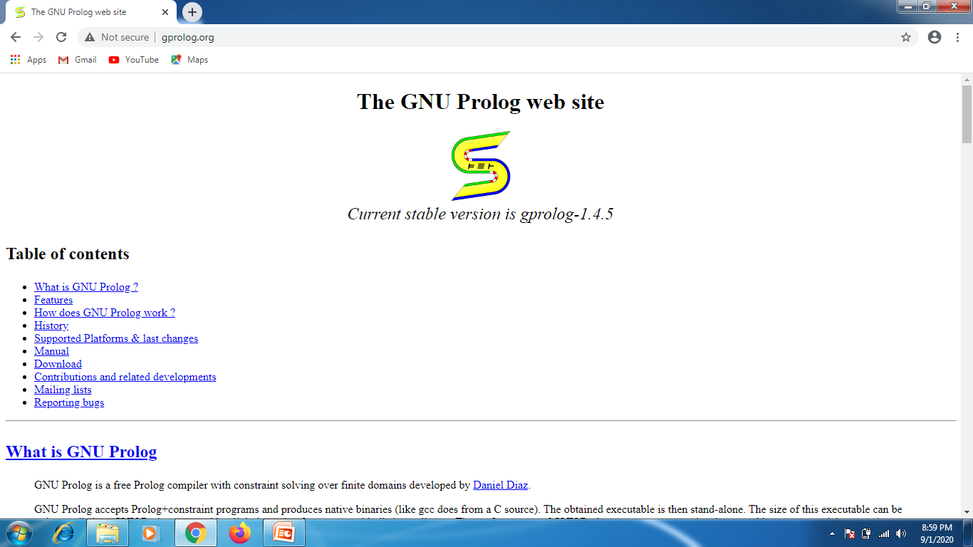
GNU Prolog Installation

Slide 11

GNU Prolog Installation

Slide 12

GNU Prolog Installation

Slide 13

First Program

Slide 14
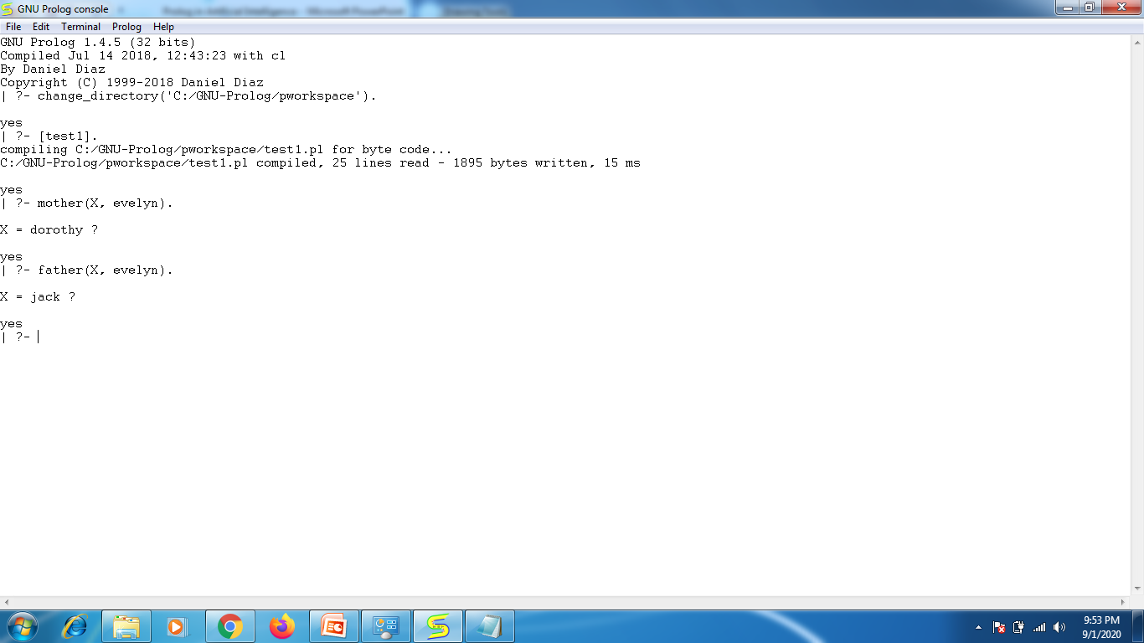
Running the First Program

Slide 15

Testing the Second Program

Slide 16
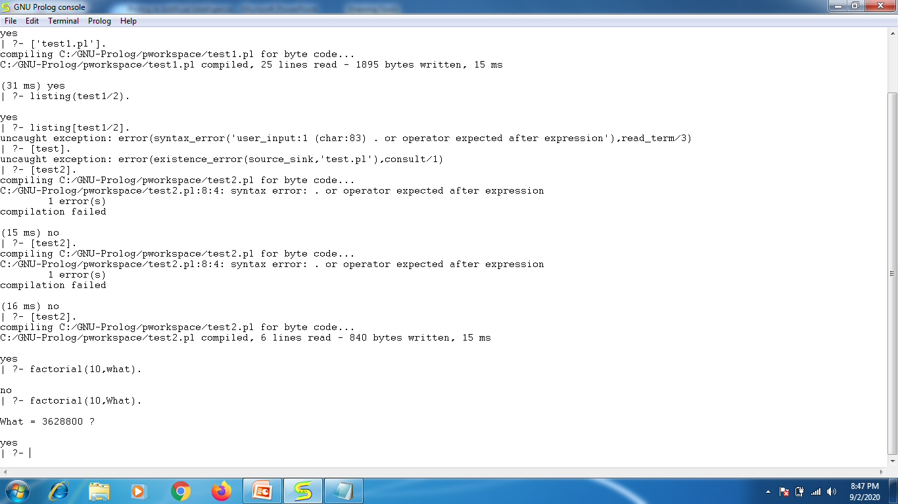
Execution of Second Program

